Slide 1
DS Case Study 2
Sanuja Chakraborty
Subasish Mula
Souptik Sarkar

Slide 2
Introduction:
What are Activation Functions? Functions that determine the output of a neural network node given an input or set of inputs.
Why are they important? They introduce non-linearity, allowing neural networks to model complex patterns.
Objectives of this Presentation:
Explore various activation functions.
Discuss their advantages and disadvantages.
Present methods to improve model accuracy.

Slide 3
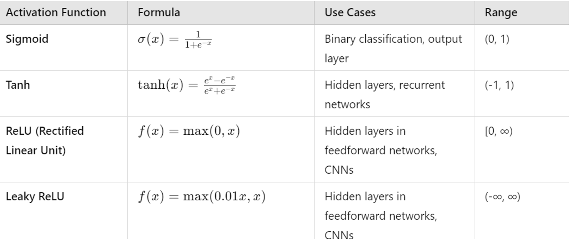
Activation Functions Explored:

Slide 4
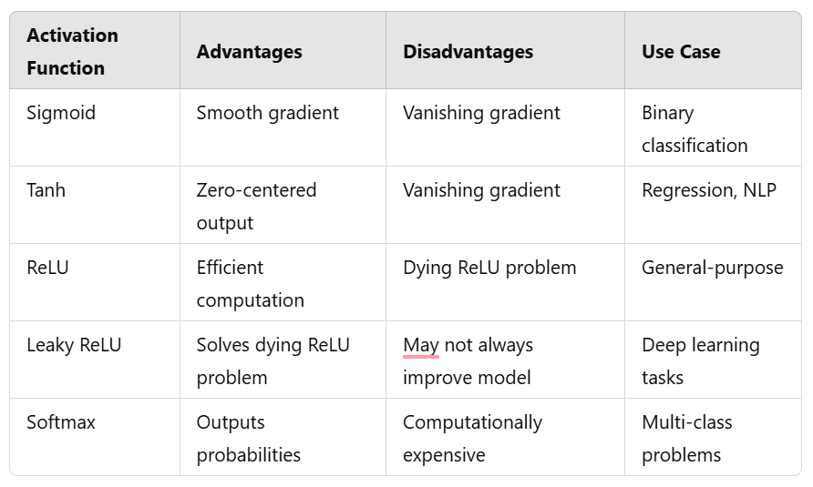
Comparison of Activation Functions

Slide 5
Methods to Improve Model Accuracy
Optimizers:
Use advanced optimizers like Adam, RMSprop, or SGD with momentum.
Loss Functions:
Experiment with Cross-Entropy Loss, Mean Squared Error, etc.
Batch Normalization:
Helps stabilize training and improve convergence.
Dropout Regularization:
Reduces overfitting by randomly dropping neurons during training.
Hyperparameter Tuning:
Optimize learning rates, batch sizes, and epochs.
Early Stopping:
Stop training once validation accuracy stops improving.
Data Augmentation:
Expand dataset with transformations to improve generalization.

Slide 6
Case Study: Sample Dataset
1. ReLU Activation Function
- Hidden Layer: 7 neurons with ReLU activation
- Output Layer: 3 neurons with softmax activation
2. Leaky ReLU Activation Function
- Hidden Layer: 7 neurons with Leaky ReLU activation (alpha=0.1)
- Output Layer: 3 neurons with softmax activation
3. Sigmoid Activation Function
- Hidden Layer: 7 neurons with sigmoid activation
- Output Layer: 3 neurons with softmax activation
4. Tanh Activation Function
- Hidden Layer: 7 neurons with sigmoid activation
- Output Layer: 3 neurons with softmax activation

Slide 7
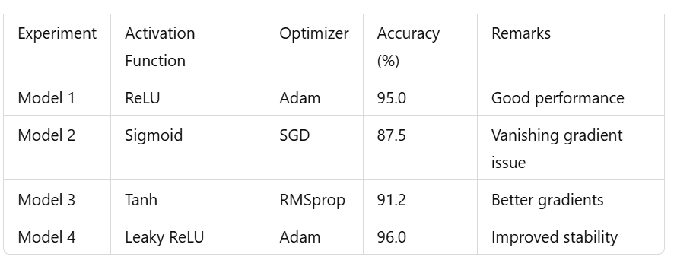
Comparison of Results

Slide 8
Insights and Recommendations
Insights:
ReLU and Leaky ReLU are effective for most tasks.
Softmax is essential for multi-class problems.
Proper choice of activation functions and optimizers significantly impacts accuracy.
Recommendations:
Start with ReLU and adapt based on task-specific needs.
Regularly tune hyperparameters and use techniques like batch normalization for optimal performance.

Slide 9
Conclusion
Key Takeaways:
Activation functions play a pivotal role in neural networks.
Each activation function has its strengths and limitations.
Combining the right activation functions with optimization techniques enhances accuracy.

Slide 10
Thank You

